Slide 1
Chapter 4 Examples

Slide 2
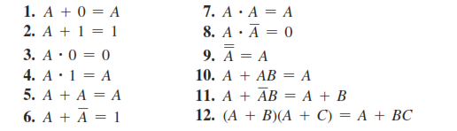
Boolean Laws

Slide 3
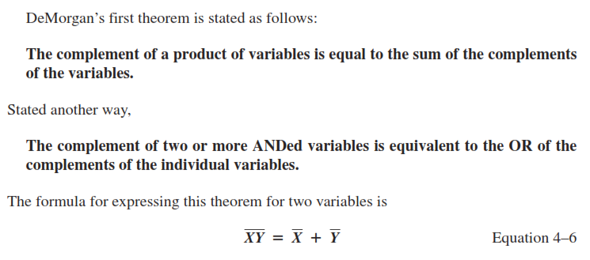
DeMorgan’s Theorem

Slide 4
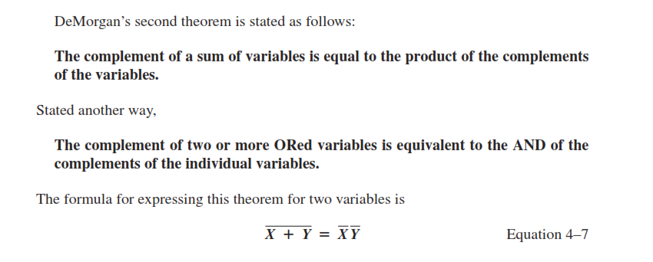
DeMorgan’s Theorem

Slide 5
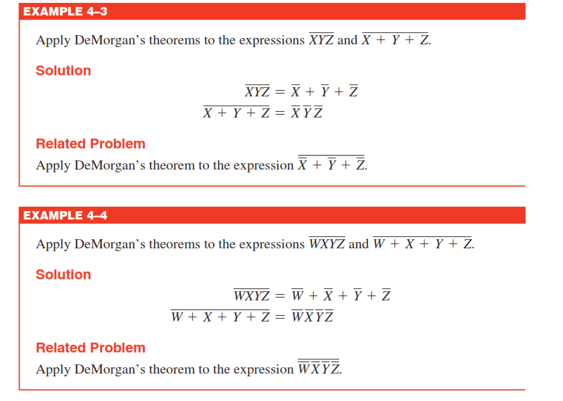
Example

Slide 6
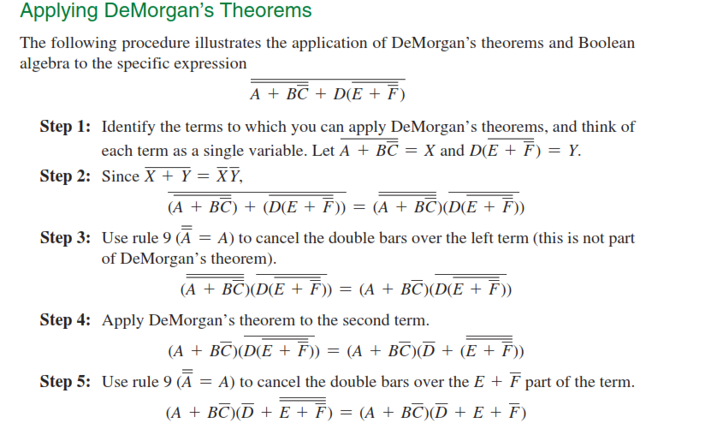

Slide 7
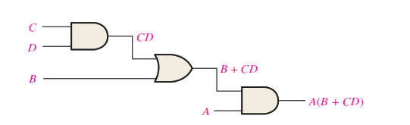
Boolean Analysis of Logical Circuit
How to write Boolean expression of logical circuit

Slide 8
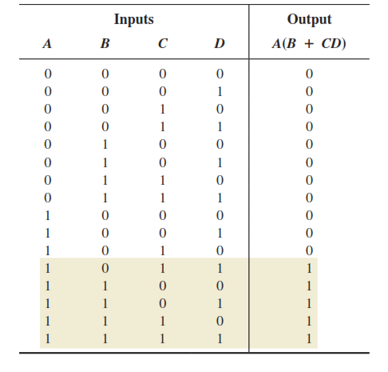
Truth Table of Pervious Circuit

Slide 9
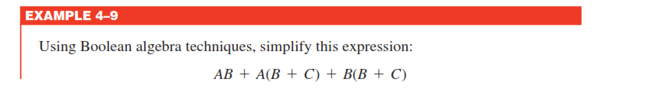
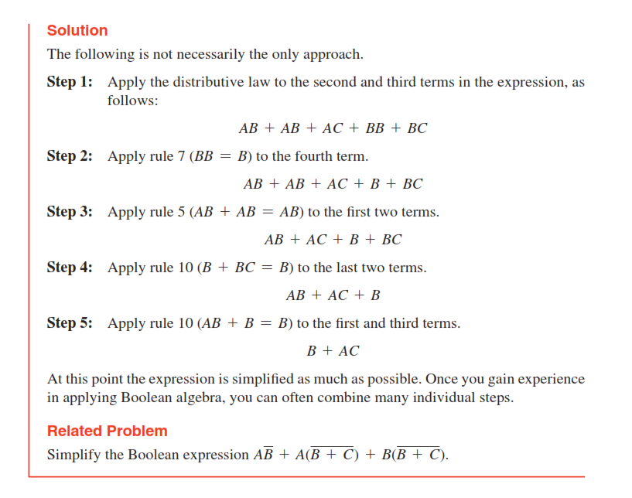
Logic Simplification Using Boolean Algebra

Slide 10
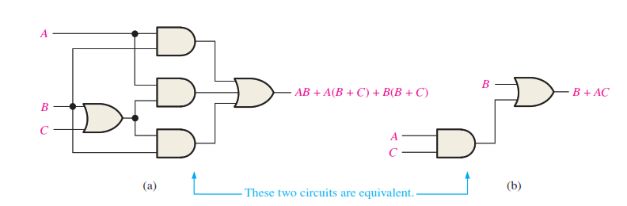
Logical Circuit After Simplification

Slide 11
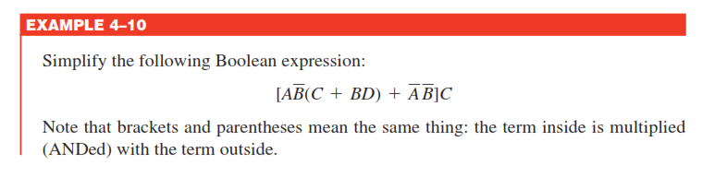
Boolean Simplification Example

Slide 12
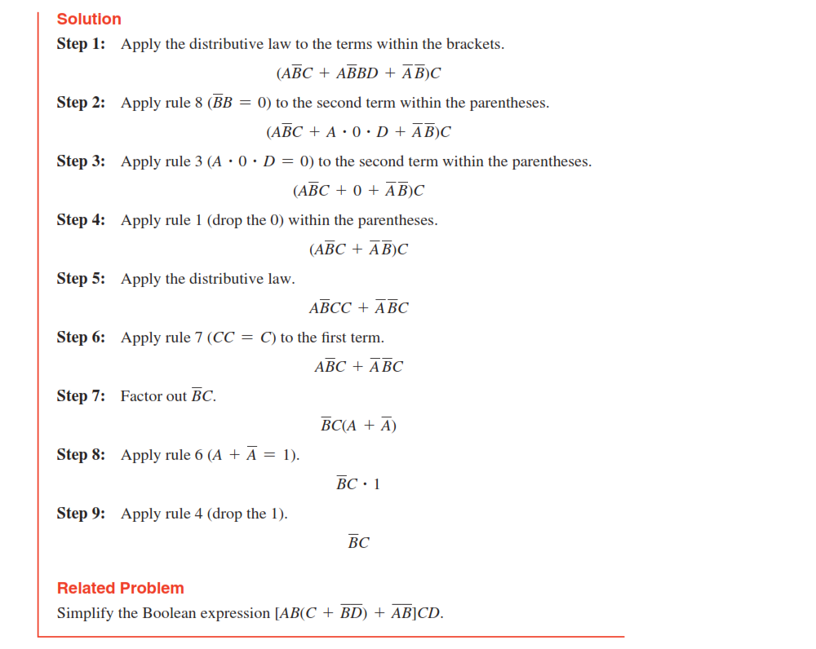

Slide 13
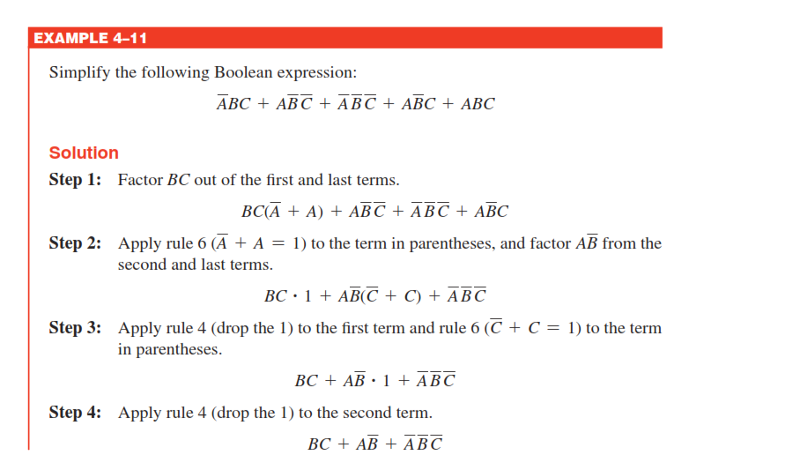

Slide 14
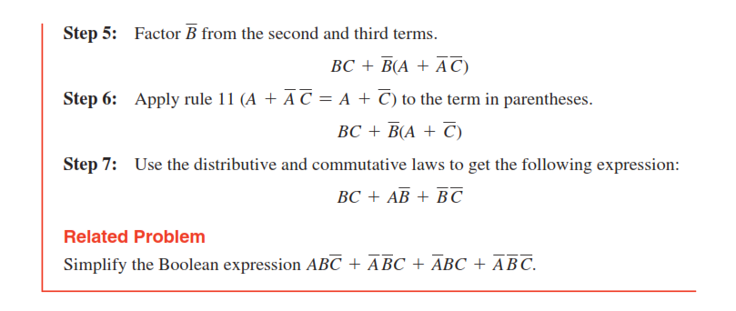

Slide 15
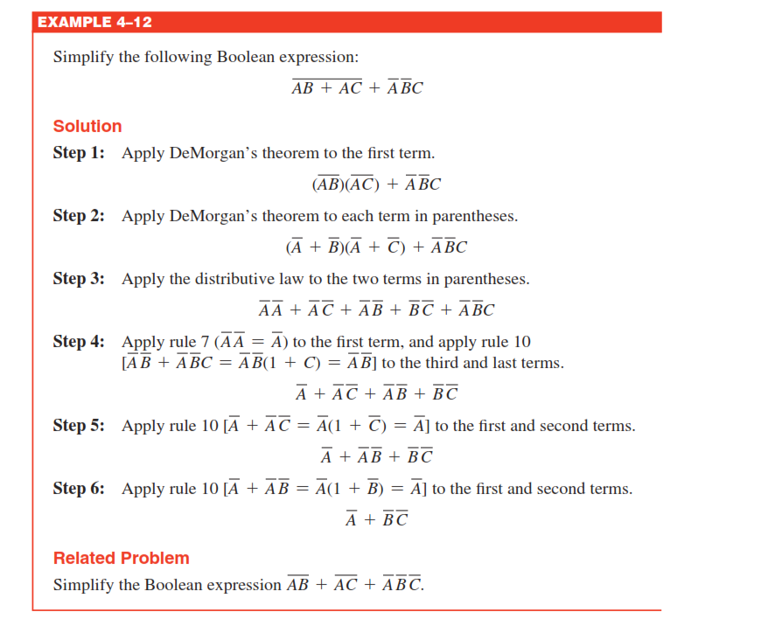

Slide 16
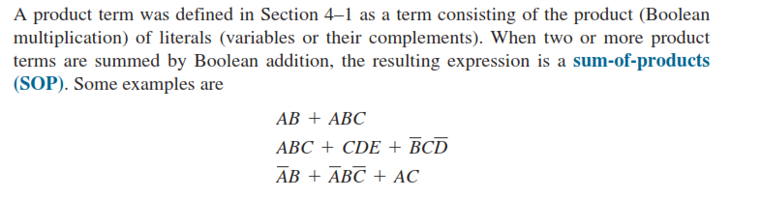
Sum of Product (SOP)

Slide 17
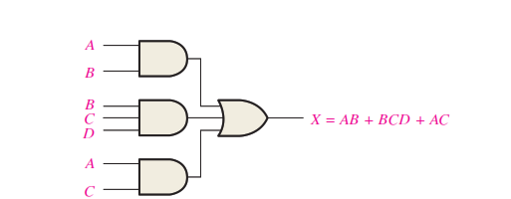
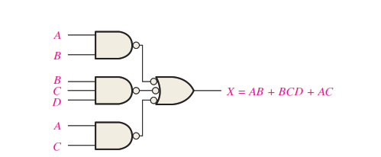

Slide 18
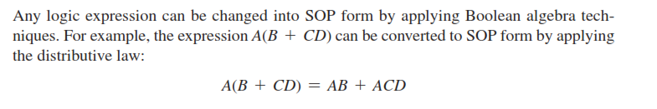
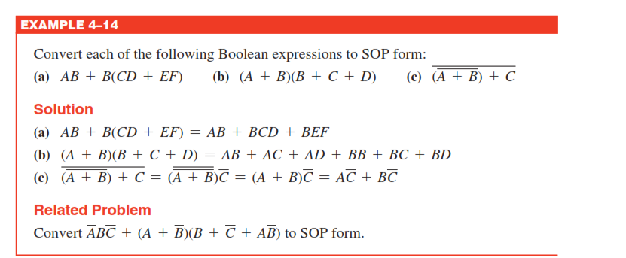
Conversion of a General Expression to SOP Form

Slide 19
Converting Product Terms to Standard SOP
Step 1: Multiply each nonstandard product term by a term made up of the sum of a missing variable and its complement. This results in two product terms. As you know, you can multiply anything by 1 without changing its value.
Step 2: Repeat Step 1 until all resulting product terms contain all variables in the domain in either complemented or un complemented form. In converting a product term to standard form, the number of product terms is doubled for each missing variable, as Example 4–15 shows.

Slide 20
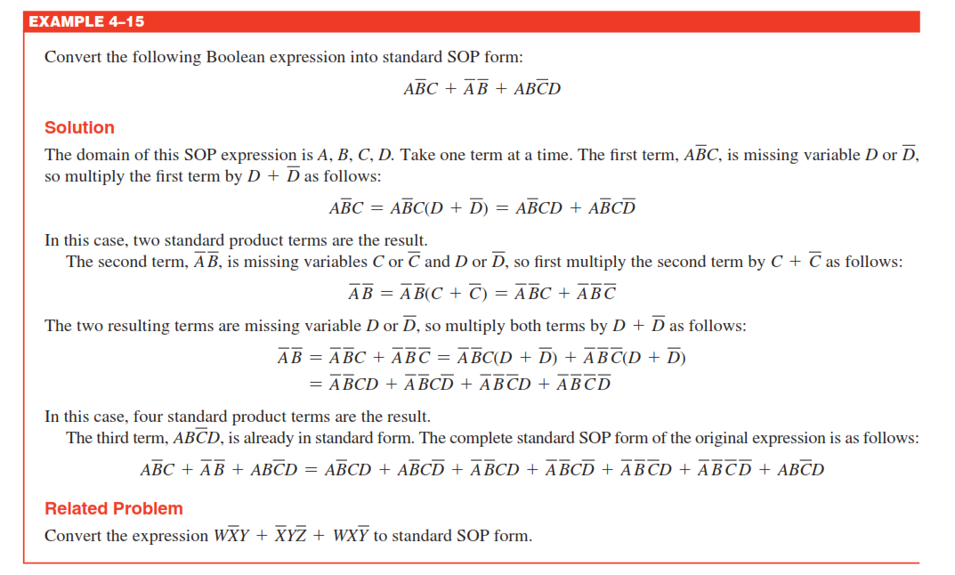

Slide 21
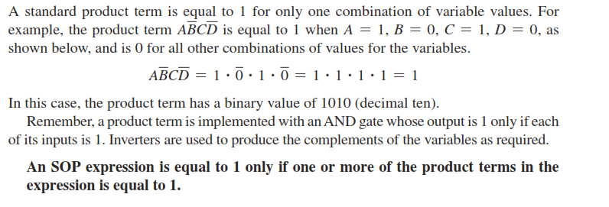
Binary Representation of a Standard Product Term

Slide 22
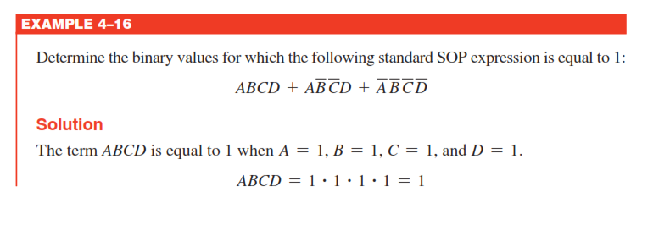
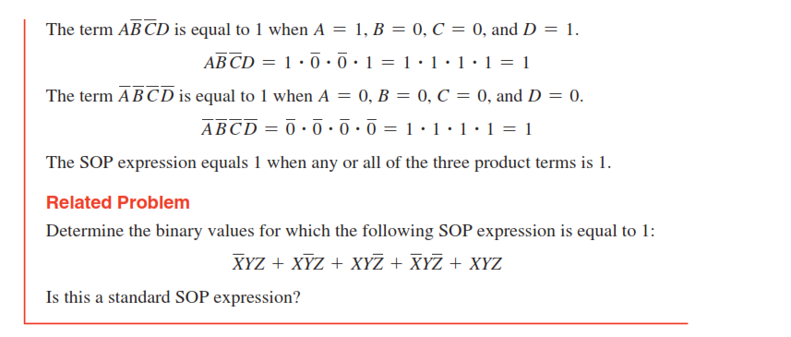

Slide 23
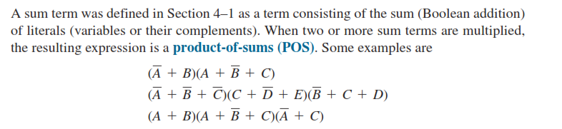
The Product-of-Sums (POS) Form

Slide 24
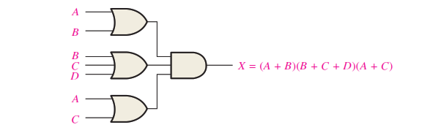
Implementation of a POS Expression

Slide 25
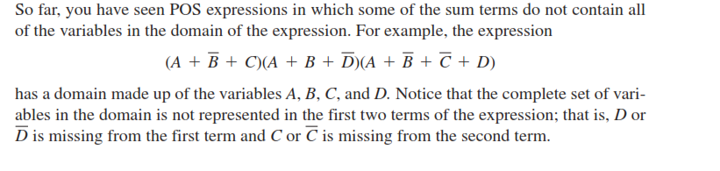
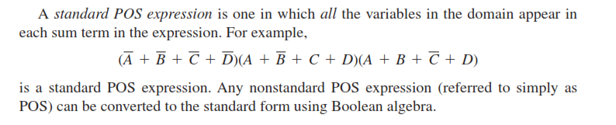
The Standard POS Form

Slide 26
Converting a Sum Term to Standard POS
Step 1: Add to each nonstandard product term a term made up of the product of the missing variable and its complement. This results in two sum terms. As you know, you can add 0 to anything without changing its value.
Step 2: Apply rule 12 from Table 4–1: A + BC=(A + B)(A + C)
Step 3: Repeat Step 1 until all resulting sum terms contain all variables in the domain in either complemented or un complemented form.

Slide 27
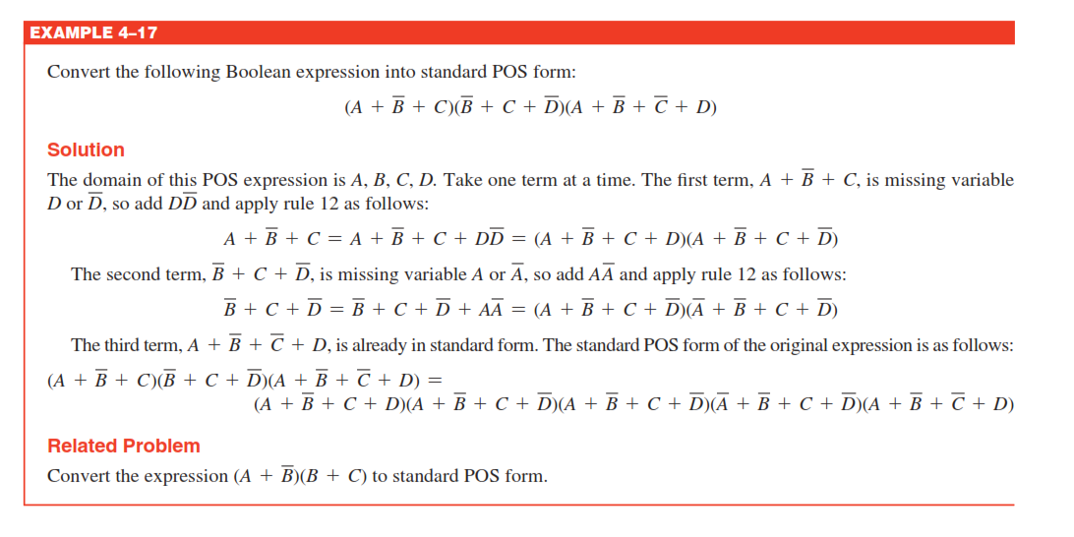

Slide 28
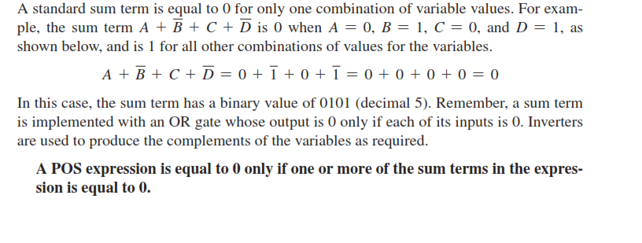
Binary Representation of a Standard Sum Term

Slide 29
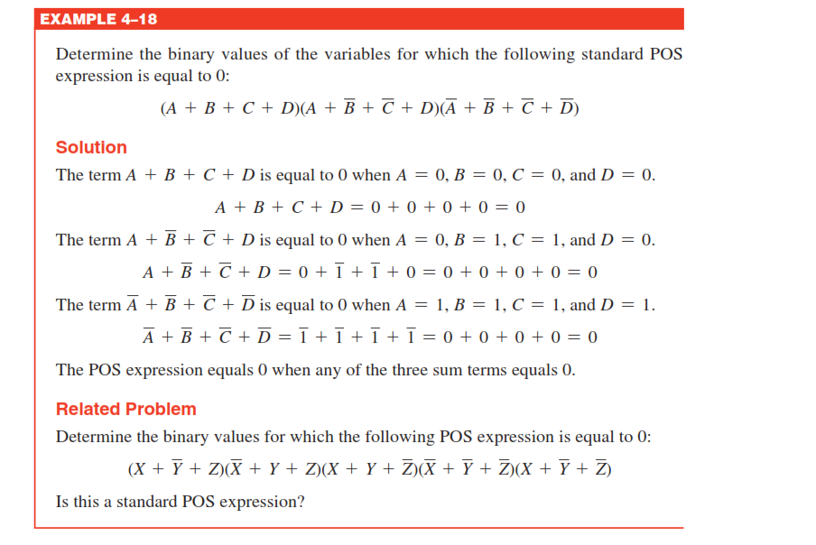

Slide 30
Converting Standard SOP to Standard POS
Step 1: Evaluate each product term in the SOP expression. That is, determine the binary numbers that represent the product terms.
Step 2: Determine all of the binary numbers not included in the evaluation in Step 1.
Step 3: Write the equivalent sum term for each binary number from Step 2 and express in POS form.

Slide 31
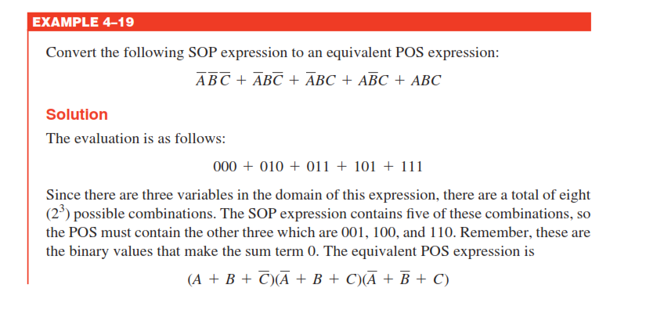

Slide 32
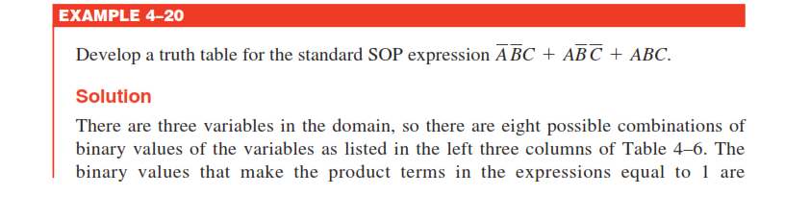
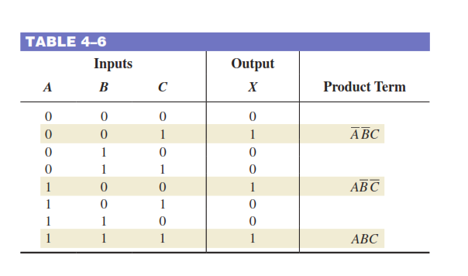
Converting SOP Expressions to Truth Table Format

Slide 33
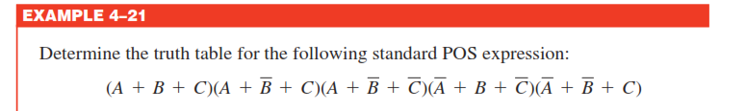
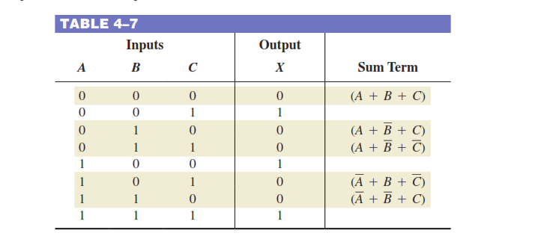
Converting POS Expressions to Truth Table Format

Slide 34
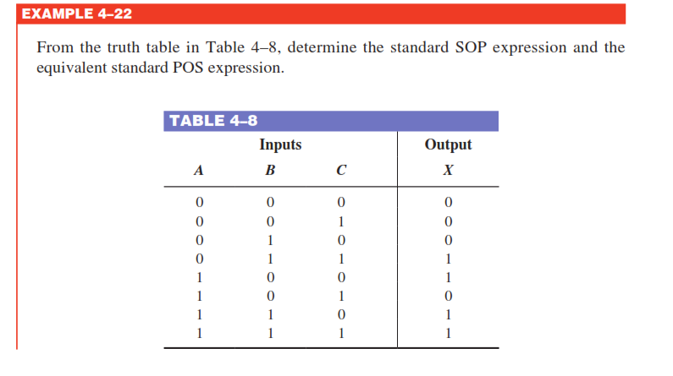
Determining Standard Expressions from a Truth Table

Slide 35
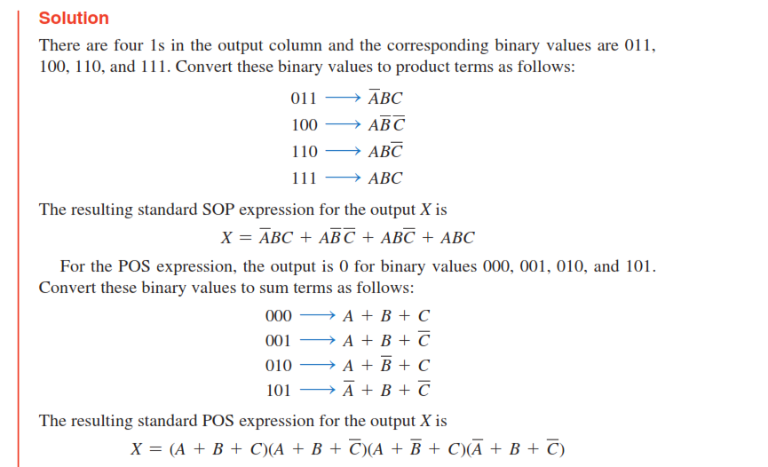

Slide 36
The Karnaugh Map
A Karnaugh map is similar to a truth table because it presents all of the possible values of input variables and the resulting output for each value. Instead of being organized into columns and rows like a truth table, the Karnaugh map is an array of cells in which each cell represents a binary value of the input variables. The cells are arranged in a way so that simplification of a given expression is simply a matter of properly grouping the cells. Karnaugh maps can be used for expressions with two, three, four, and five variables, but we will discuss only 3-variable and 4-variable situations to illustrate the principles.

Slide 37
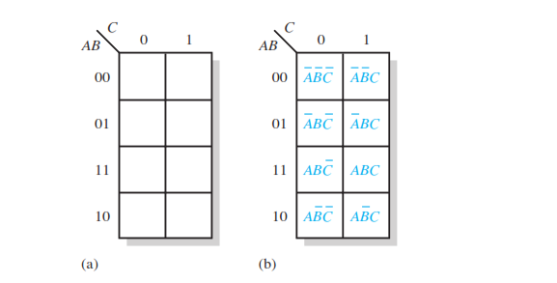
The 3-Variable Karnaugh Map

Slide 38
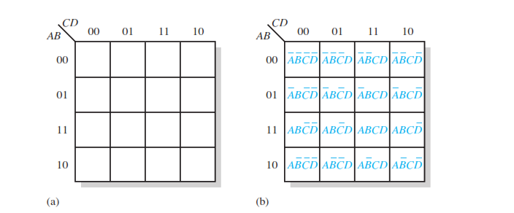
The 4-Variable Karnaugh Map

Slide 39
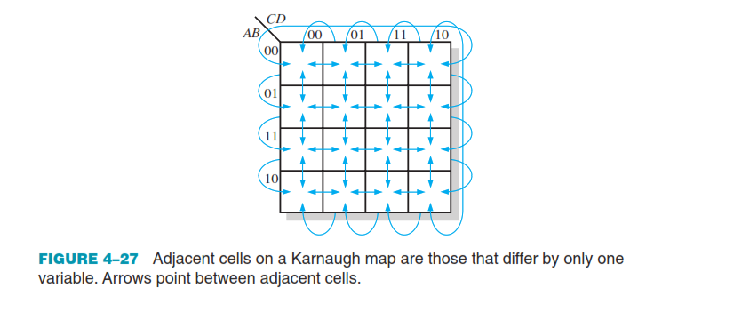

Slide 40
Karnaugh Map SOP Minimization
Mapping a Standard SOP Expression
Step 1: Determine the binary value of each product term in the standard SOP expression. After some practice, you can usually do the evaluation of terms mentally.
Step 2: As each product term is evaluated, place a 1 on the Karnaugh map in the cell having the same value as the product term.

Slide 41
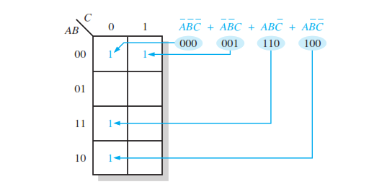

Slide 42
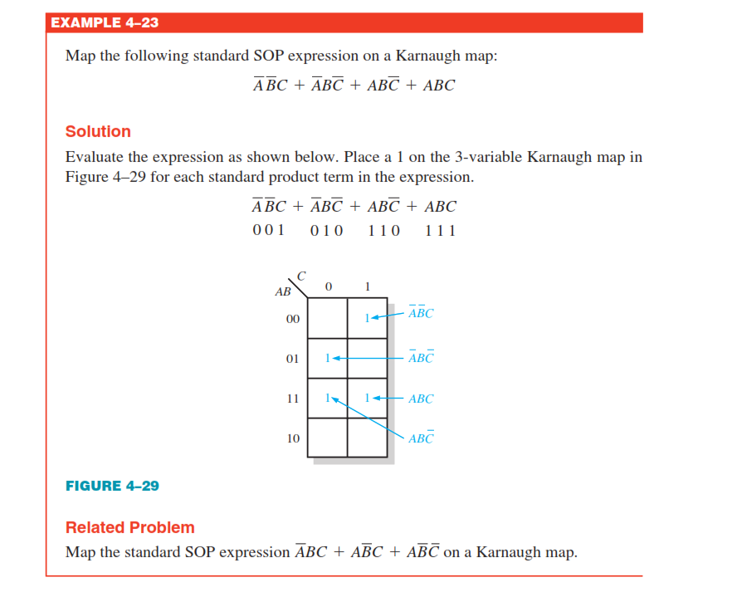
Example

Slide 43
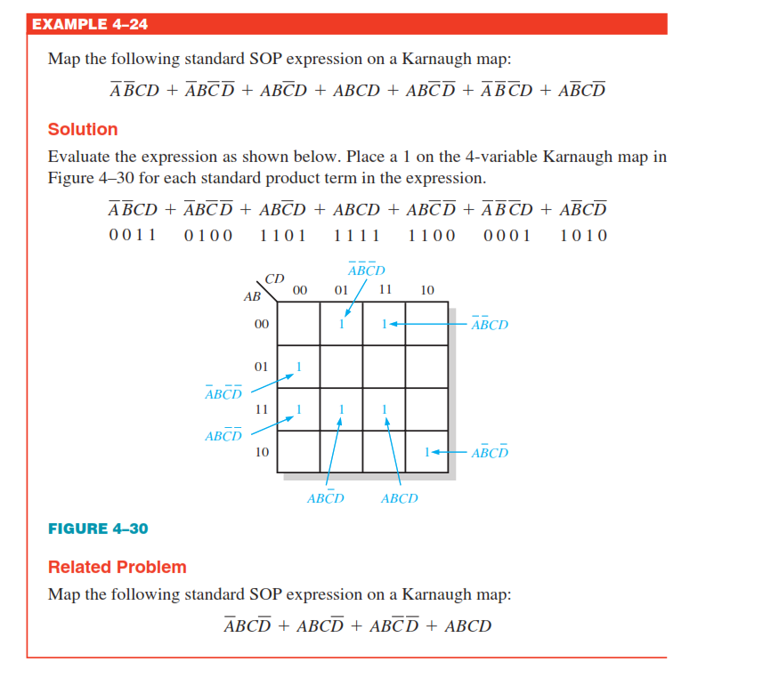

Slide 44
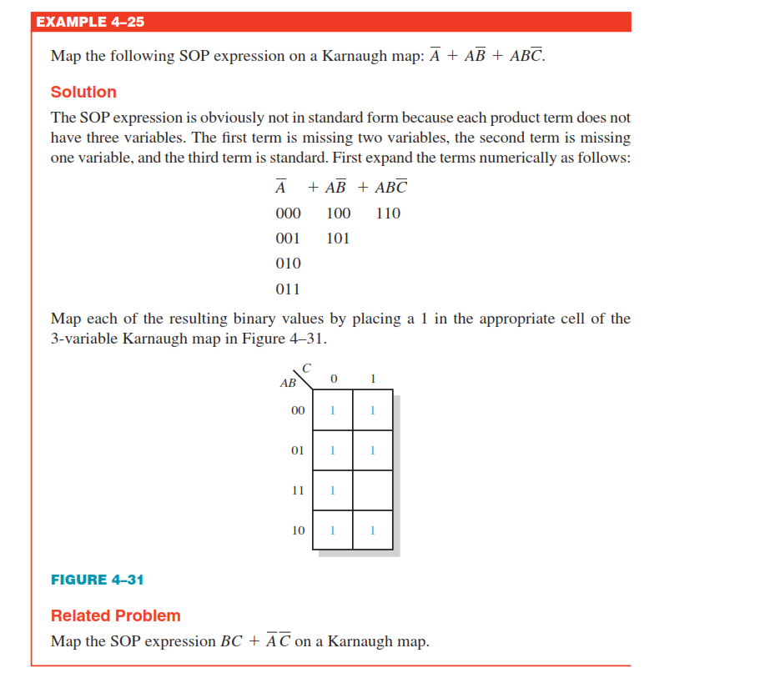
Mapping a Nonstandard SOP Expression

Slide 45
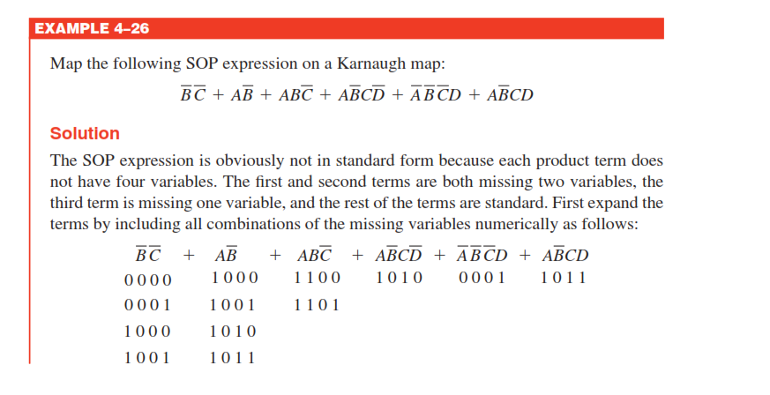

Slide 46
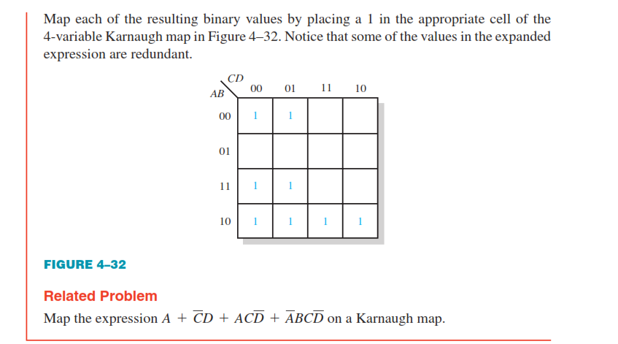

Slide 47
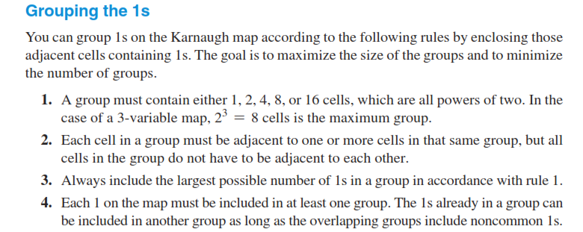
Karnaugh Map Simplification of SOP Expressions

Slide 48
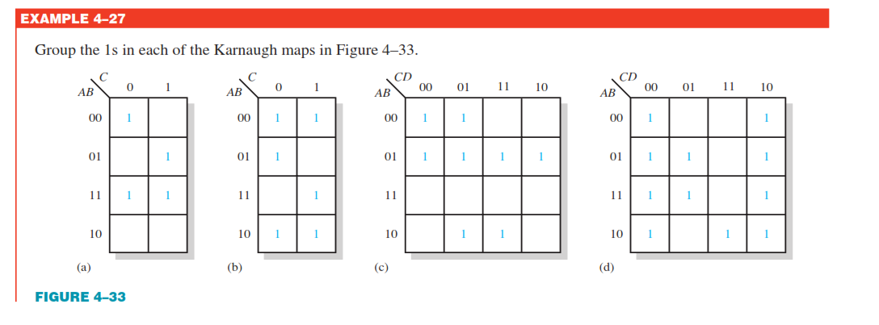

Slide 49
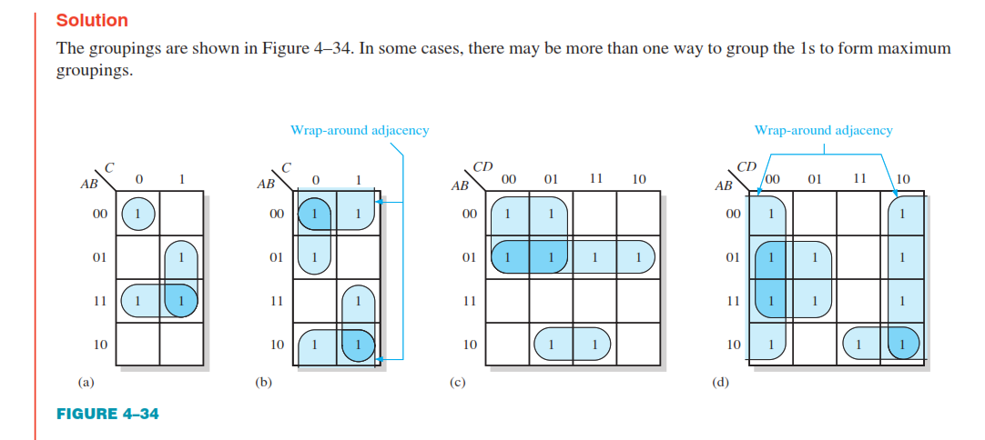

Slide 50

Determining the Minimum SOP Expression from the Map

Slide 51



Slide 52


Slide 53


Slide 54



Slide 55



Slide 56

Mapping Directly from a Truth Table

